Slide 1
the quantity of berth in inland and costal port.

Slide 2
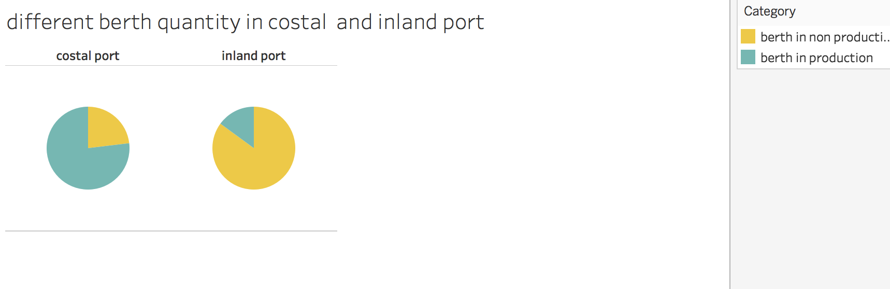

Slide 3
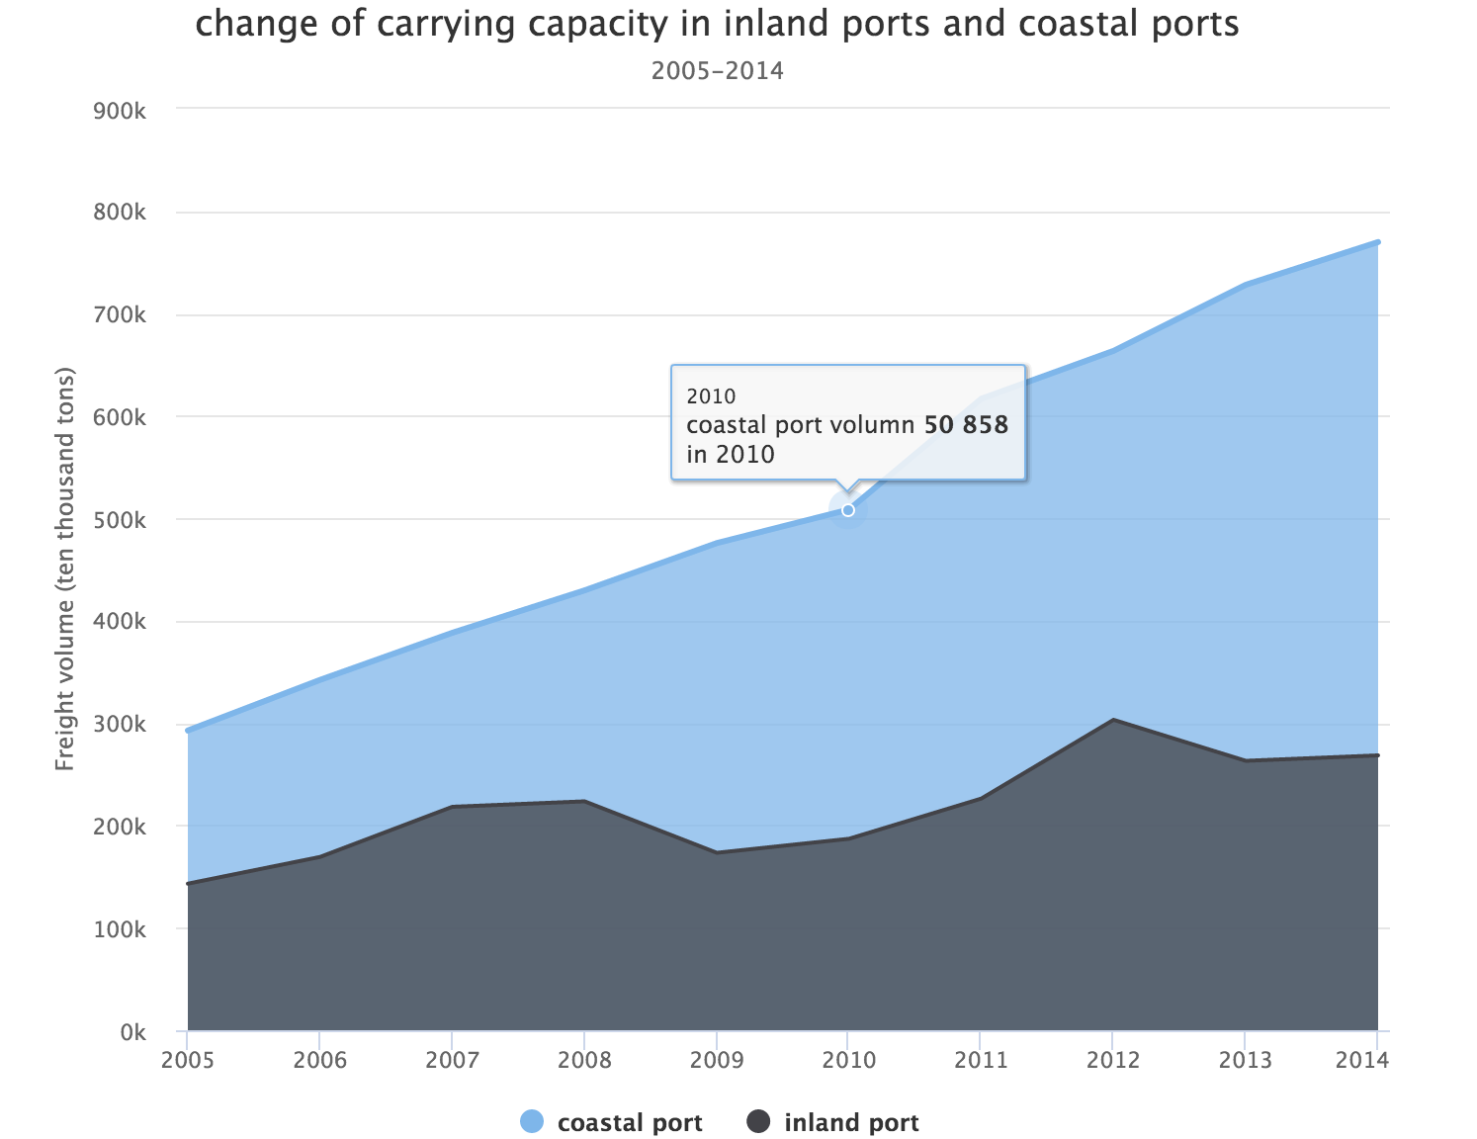
Both in inland and costal port , the volume of carrying capacity is rising . The volume of carrying capacity in costal port is almost twice of that in inland port. Almost the quantity of the berth in every port increases as time goes by .And the increasing speed of the quantity of costal berth is faster..

